Slide 1
Spatial Domain Operations
Third Meeting
Shinta Estri

Slide 2
Common Spatial Domain Operations
Point Processing:
Image enhancement: Adjusting contrast, brightness, or color balance.
Thresholding: Creating binary images based on a threshold value.
Histogram equalization: Stretching the histogram to improve contrast.
Neighborhood Processing:
Smoothing: Reducing noise and blurring edges.
Sharpening: Enhancing edges and details.
Morphological operations: Erosion, dilation, opening, and closing for shape analysis and modification.
Geometric Transformations:
Translation: Shifting the image.
Rotation: Rotating the image.
Scaling: Changing the size of the image.
Shearing: Skewing the image.

Slide 3
Neighborhood Processing:
Neighborhood processing is a technique in image processing where the value of each pixel in the output image is determined by the values of pixels in a local neighborhood of the corresponding pixel in the input image. This neighborhood is typically a square or a rectangle centered around the pixel of interest.
Smoothing: Reducing noise and blurring edges.
Sharpening: Enhancing edges and details.

Slide 4
Smoothing:
Averaging: The value of each pixel in the output image is replaced by the average of the pixel values in its neighborhood. This reduces noise and blurs edges.
Median filtering: The value of each pixel in the output image is replaced by the median of the pixel values in its neighborhood. This is more robust to noise than averaging and preserves edges better.
Gaussian filtering: Weights are assigned to pixels in the neighborhood based on a Gaussian distribution, with the center pixel having the highest weight. This produces a smoother result than averaging or median filtering.

Slide 5
Smoothing Averaging:
A Technique for Noise Reduction
Smoothing averaging is a simple technique used to reduce noise in images. It involves replacing the value of each pixel with the average of the pixel values in its neighborhood. This process helps to smooth out random fluctuations in the image intensity, making the image appear less noisy.

Slide 6
Kernel for Smoothing Averaging
The kernel for smoothing averaging is typically a square matrix of equal values, where the sum of all elements is 1.
For example, a 3x3 averaging kernel would be:
1/9 1/9 1/9
1/9 1/9 1/9
1/9 1/9 1/9

Slide 7
https://youtu.be/07qT2L1ZKQA?si=VSbDIspLneEdBCur

Slide 8
Median Filtering:
A Noise Reduction Technique
Median filtering is a non-linear technique used to reduce noise in images while preserving edges. It replaces each pixel's value with the median of the pixel values in its neighborhood. This helps to remove outliers (e.g., noise spikes) without significantly blurring edges.

Slide 9
How Median Filtering Works
Neighborhood Selection: A neighborhood (e.g., a 3x3 square) is defined around each pixel.
Pixel Value Sorting: The pixel values within the neighborhood are sorted in ascending order.
Median Calculation: The median value (the middle value in the sorted list) is determined.
Pixel Value Replacement: The original pixel's value is replaced with the calculated median value.

Slide 10
Explanation:
Load the image: Load the noisy image you want to smooth.
Apply median filtering: Use cv2.medianBlur to apply median filtering to the image. The kernel size (3 in this example) determines the size of the neighborhood.
Note: The kernel size can be adjusted to control the amount of smoothing. A larger kernel size will result in more smoothing but may also blur edges.

Slide 11
Advantages & Disadvantages
Advantages of Median Filtering:
Effective noise reduction: It can effectively remove noise, especially impulsive noise (e.g., salt-and-pepper noise).
Edge preservation: It can preserve edges better than averaging techniques.
Robustness: It is less sensitive to outliers compared to averaging techniques.
Disadvantages of Median Filtering:
Computational cost: It can be computationally expensive for large images and large kernel sizes.
Blurring: While it preserves edges better than averaging, it can still introduce some blurring.

Slide 12
https://youtu.be/TYNbTdzm-5w?si=T9zSjSBk7rPOyrsJ

Slide 13
Gaussian Filtering:
A Smoothing Technique
Gaussian filtering is a widely used technique for smoothing images. It involves convolving an image with a Gaussian kernel, which is a 2D Gaussian function. This process helps to reduce noise and blur edges.

Slide 14
Gaussian Kernel
A Gaussian kernel is a matrix of weights, where the values are distributed according to a Gaussian distribution. The center pixel has the highest weight, and the weights decrease as you move away from the center. The standard deviation of the Gaussian distribution controls the amount of blurring.

Slide 15
Explanation:
Load the image: Load the noisy image you want to smooth.
Apply Gaussian filtering: Use cv2.GaussianBlur to apply Gaussian filtering to the image. The first two arguments specify the kernel size (5x5 in this example) and the standard deviation (0).
Note:
Kernel size: A larger kernel size will result in more blurring, while a smaller kernel size will result in less blurring.
Standard deviation: A larger standard deviation will result in more blurring, while a smaller standard deviation will result in less blurring.

Slide 16
How Gaussian Filtering Works
Convolution: The Gaussian kernel is slid over the image, pixel by pixel.
Multiplication: At each position, the kernel elements are multiplied by the corresponding pixel values in the image.
Summation: The products are summed to obtain the new pixel value.
Gaussian filtering is a powerful technique for smoothing images while preserving edges.

Slide 17
Gaussian kernel
Example of a 3x3 Gaussian kernel with a standard deviation of 1:
0.0625 0.25 0.0625
0.25 0.4 0.25
0.0625 0.25 0.0625

Slide 18
How to calculate a Gaussian kernel:
Determine the kernel size. This is typically an odd number, such as 3, 5, or 7.
Calculate the standard deviation. This controls the amount of blurring. A larger standard deviation will result in more blurring.
Use the following formula to calculate the elements of the kernel:
kernel[i, j] = (1 / (2 * pi * sigma^2)) * exp(-((i - (kernel_size - 1) / 2)^2 + (j - (kernel_size - 1) / 2)^2) / (2 * sigma^2))

Slide 19
where:
kernel[i, j] is the element at row i and column j of the kernel.
sigma is the standard deviation.
kernel_size is the size of the kernel.

Slide 20
5x5 Gaussian kernel
To calculate a 5x5 Gaussian kernel with a standard deviation of 1, you would use the following formula:
kernel[i, j] = (1 / (2 * pi * 1^2)) * exp(-((i - 2)^2 + (j - 2)^2) / (2 * 1^2))
This would result in the following kernel:
0.0039 0.0133 0.0219 0.0133 0.0039
0.0133 0.0448 0.0735 0.0448 0.0133
0.0219 0.0735 0.1208 0.0735 0.0219
0.0133 0.0448 0.0735 0.0448 0.0133
0.0039 0.0133 0.0219 0.0133 0.0039

Slide 21
Sharpening:
Laplacian sharpening: The Laplacian operator is applied to the image, which highlights edges. The original image is then added to the Laplacian-filtered image to enhance edges.
Unsharp masking: The original image is subtracted from a blurred version of itself, and the result is added to the original image. This enhances edges and details.

Slide 22
Laplacian sharpening
Laplacian sharpening is a technique used to enhance edges in an image. It involves convolving the image with a Laplacian operator, which is a 2D discrete Laplacian. The Laplacian operator highlights regions of rapid change in intensity, which correspond to edges.
The Laplacian sharpening technique works by convolving an image with a Laplacian operator, which is a 2D discrete Laplacian. This operator highlights regions of rapid change in intensity, which correspond to edges.
Convolution with Laplacian operator: The Laplacian operator is a 3x3 kernel that looks like this:
0 1 0
1 -4 1
0 1 0
When this kernel is convolved with the image, it calculates the second-order derivative of the image intensity at each pixel. The result is a new image where edges are highlighted as peaks or valleys.

Slide 23
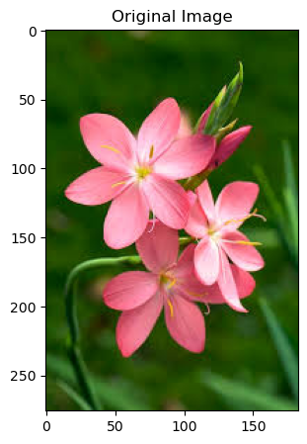
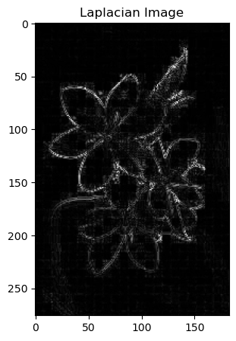
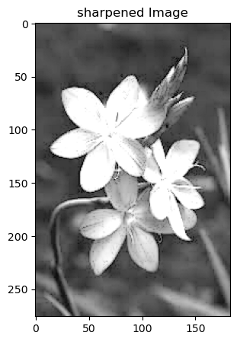

Slide 24
Explanation:
Load the image: Load the image you want to sharpen.
Convert to grayscale: Convert the image to grayscale for simpler processing.
Apply Laplacian: Use the cv2.Laplacian function to apply the Laplacian operator to the grayscale image. The result is a 64-bit floating-point image.
Convert to absolute value: Convert the Laplacian result to absolute values to ensure positive values for the subsequent addition.
Convert to 8-bit: Convert the Laplacian result to 8-bit unsigned integers for display.
Combine with original: Add a weighted sum of the original grayscale image and the Laplacian result. The weights can be adjusted to control the level of sharpening.

Slide 25
Unsharp masking
Unsharp masking is a popular technique for enhancing the edges and details in an image. It involves subtracting a blurred version of the original image from the original image itself. This process highlights the differences between the original and blurred images, which are primarily located at edges and other sharp features.

Slide 26
How Unsharp Masking Works
Blurring: The original image is blurred using a low-pass filter (e.g., Gaussian blur). This reduces the high-frequency components of the image, leaving behind a smoothed version.
Subtraction: The blurred image is subtracted from the original image. This creates a mask that emphasizes the differences between the original and blurred images, highlighting edges and details.
Addition: The mask is added back to the original image, with a weight that controls the level of sharpening. A higher weight will result in more sharpening, while a lower weight will result in less sharpening.

Slide 27


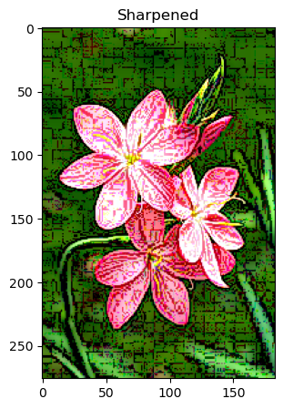

Slide 28
np.uint8(...):
Converts the resulting array (after clipping) to an unsigned 8-bit integer data type.
This ensures that the pixel values in the stretched_img array are within the valid range for image pixels.

Slide 29
np.clip(..., 0, 255):
Limits the pixel values to the range 0-255.
This is essential because pixel values in images are typically represented by 8-bit unsigned integers (uint8), which can only hold values from 0 to 255.
if a pixel value exceeds 255, it is clipped to 255, and if it falls below 0, it is clipped to 0.

Slide 30
Stretching the histogram to improve contrast.
Exercise: Histogram Stretching
Goal: To stretch the histogram of an image to improve its contrast.
Steps:
Load an image: Choose an image with low contrast.
Calculate the histogram: Determine the frequency of each pixel value in the image.
Find the minimum and maximum pixel values: Identify the darkest and brightest pixels in the image.
Calculate the stretching factor: Determine the ratio between the desired maximum pixel value (e.g., 255) and the current maximum pixel value.
Stretch the histogram: For each pixel, multiply its value by the stretching factor.
Clip the values: If any pixel values exceed the maximum allowable value (e.g., 255), set them to the maximum.
Display the original and stretched images: Compare the images to see the improvement in contrast.

Slide 31
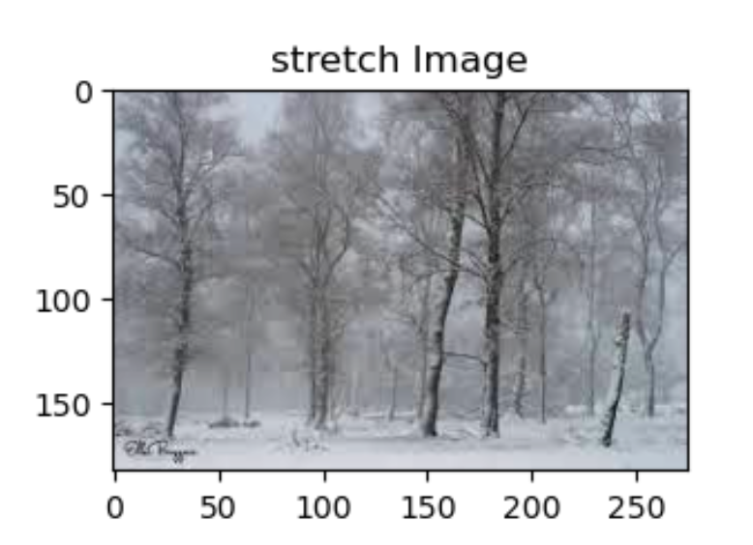
stretching factor
# Calculate the stretching factor
stretch_factor = 255 / (max_val - min_val)
# Stretch the histogram
stretched_img = np.uint8(np.clip((img - min_val) * stretch_factor, 0, 255))

Slide 32
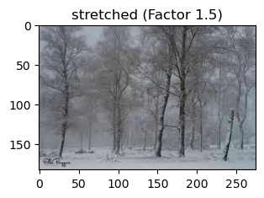
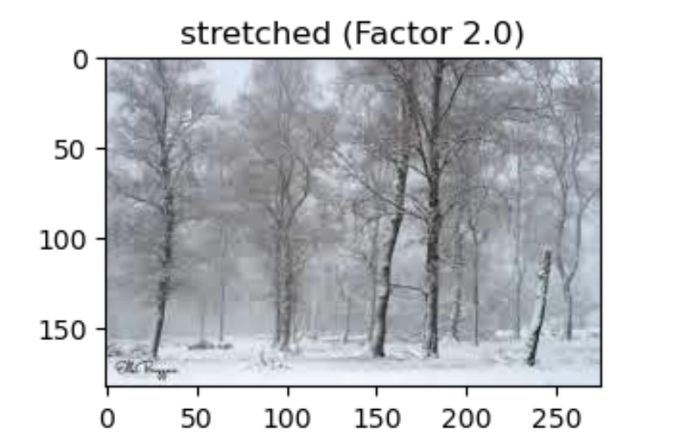
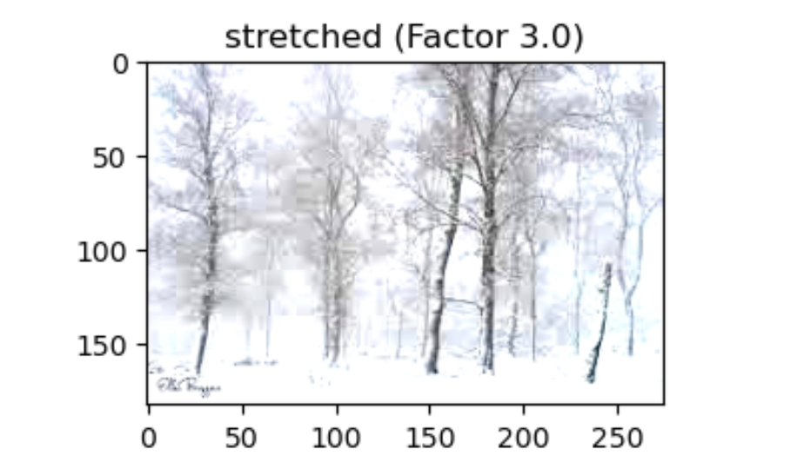
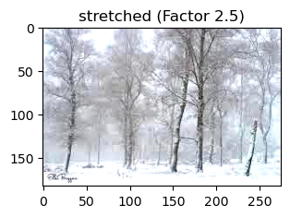

Slide 33
Observations:
Smaller factors (e.g., 1.5): Produce a more subtle contrast enhancement.
Larger factors (e.g., 3.0): Create a more dramatic increase in contrast, potentially emphasizing details but also introducing noise.
Optimal factor: The best stretching factor depends on the specific image and desired outcome. Experimentation is key to finding the right balance.

Slide 34
Morphological operations:
Erosion,
dilation,
opening,
and closing
for shape analysis and modification.

Slide 35
erosion
The erosion process is a fundamental operation used to smooth images, especially by removing small noise or details, particularly in binary or grayscale images.
Before erosion: A binary image with small noise (small white dots).
After erosion: The small white dots are removed, and the edges of objects in the image become more defined.
Effect: Erosion shrinks objects and removes small details.

Slide 36
step-by-step guide to how the erosion process works:
Step 1: Define the Image
Start with a binary image (black and white) or a grayscale image.
In a binary image, pixels are either 0 (black) or 1 (white).
In a grayscale image, pixels can take values between 0 (black) and 255 (white).
Step 2: Choose a Structuring Element
Select a structuring element (kernel). This is a small matrix, usually 3x3 or 5x5, that defines the neighborhood over which the erosion operation will be applied.
Common choices for the structuring element are:
Square
Diamond
Circle

Slide 37
Cont.
Step 3: Place the Structuring Element Over the Image
For each pixel in the image, place the center of the structuring element on top of the pixel, effectively aligning the kernel over the neighborhood of the pixel.
Step 4: Compare the Neighborhood
For binary images: Check if all the pixels under the structuring element are white (1).
If all the corresponding pixels in the image match the structure of the kernel (all 1s), the center pixel is kept as 1.
If not, the center pixel is set to 0 (eroded away).
For grayscale images: Compare the pixel values within the region covered by the structuring element.
Take the minimum value of the neighborhood and assign it to the center pixel.

Slide 38
Cont.
Step 5: Move the Structuring Element
Slide the structuring element over to the next pixel, usually in a raster scan (left to right, top to bottom).
Repeat the erosion process for each pixel in the image.
Step 6: Repeat the Process
If further erosion is needed (to smooth more), the process can be repeated multiple times.
The more you erode, the more small details and thin structures will be removed from the image.
Step 7: Resulting Image
The result is a smoother image with small objects and noise removed. Thin structures may also be reduced or eliminated.

Slide 39
structuring element (kernel) moves
To understand how the structuring element (kernel) moves across an image during erosion, let's break it down step-by-step with an example using a simple 5x5 binary image and a 3x3 structuring element.
Binary Image (5x5):
1 1 1 0 0
1 0 1 0 0
1 1 1 1 1
0 0 1 1 0
0 0 1 1 1
Where: 1 represents a white pixel. 0 represents a black pixel.

Slide 40
Structuring Element (3x3):
1 1 1
1 1 1
1 1 1
The structuring element (or kernel) is applied to each pixel and its 8 neighbors. It moves across the entire image, starting from the top-left corner.

Slide 41
Step-by-Step Example of Moving the Structuring Element
Initial Position: Centered on Pixel (1,1)
The structuring element is first placed over the top-left corner, centered on the first pixel (1,1):
Image: Structuring Element (Kernel):
1 1 1 0 0 1 1 1
1 0 1 0 0 --> 1 1 1 (aligned with the first pixel at position (1,1))
1 1 1 1 1 1 1 1
The kernel covers the area around pixel (1,1).
Check if all the corresponding pixels in this 3x3 region in the image are 1.
If they are not (like in this case, where there's a 0 in the middle row), the center pixel is eroded to 0.

Slide 42
Move the Structuring Element Right: Centered on Pixel (1,2)
Now, the kernel moves one pixel to the right, centered on pixel (1,2):
Image: Structuring Element:
1 1 1 0 0 1 1 1
1 0 1 0 0 --> 1 1 1 (aligned with the second pixel at position (1,2))
1 1 1 1 1 1 1 1
The kernel now covers the neighborhood around pixel (1,2).
If the corresponding pixels in the image match the structuring element (all 1s), the pixel remains unchanged. If not, the center pixel is eroded (set to 0).

Slide 43
Continue Moving the Structuring Element Across the Image
Repeat this process for each pixel in the image. The kernel moves left-to-right along the row, and once it finishes the first row, it moves down to the next row.
For example:
Center on (1,3): Check the neighborhood and apply the same rule.
Center on (1,4): Move to the next pixel.
After finishing the top row, move down to the second row, center the kernel on (2,1), and repeat.

Slide 44
Final Eroded Image:
After the entire image is processed using the erosion operation, the final image will look something like this (assuming the structuring element is applied thoroughly):
1 0 0 0 0
0 0 0 0 0
1 0 0 0 1
0 0 0 0 0
0 0 0 0 0
In this example:
Small clusters of white pixels have been eroded away.
The remaining pixels are the ones whose surrounding pixels matched the kernel configuration.

Slide 45
Summary of Movement:
The kernel starts at the top-left of the image.
It moves horizontally across the row.
When the end of a row is reached, it moves vertically down to the next row.
This process continues until the kernel covers the entire image.
This movement is often called a sliding window operation, as the structuring element "slides" over the image, pixel by pixel.

Slide 46
Dilation
Process:
Place the structuring element: Place the structuring element at each pixel in the image.
Check for overlap: If any of the pixels in the structuring element overlap with an object pixel, the current pixel is set to 1.
Add pixels: This process adds pixels to the boundaries of objects.
Effect: Dilation expands objects and fills in holes.

Slide 47
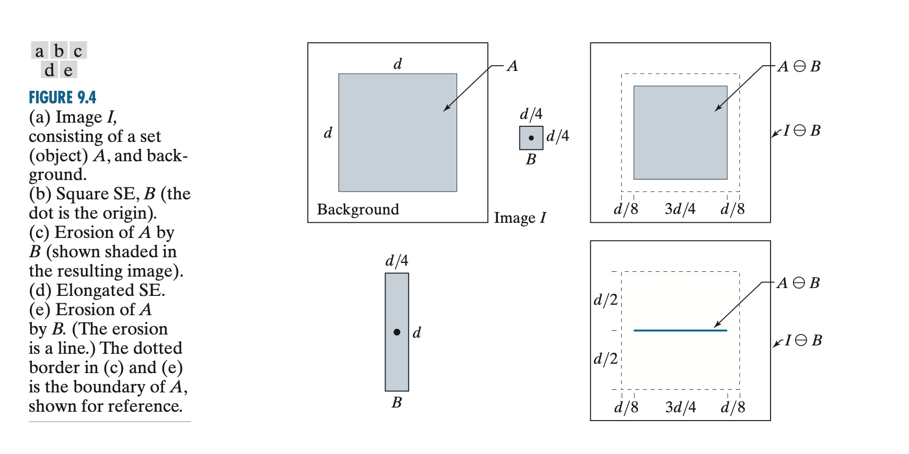
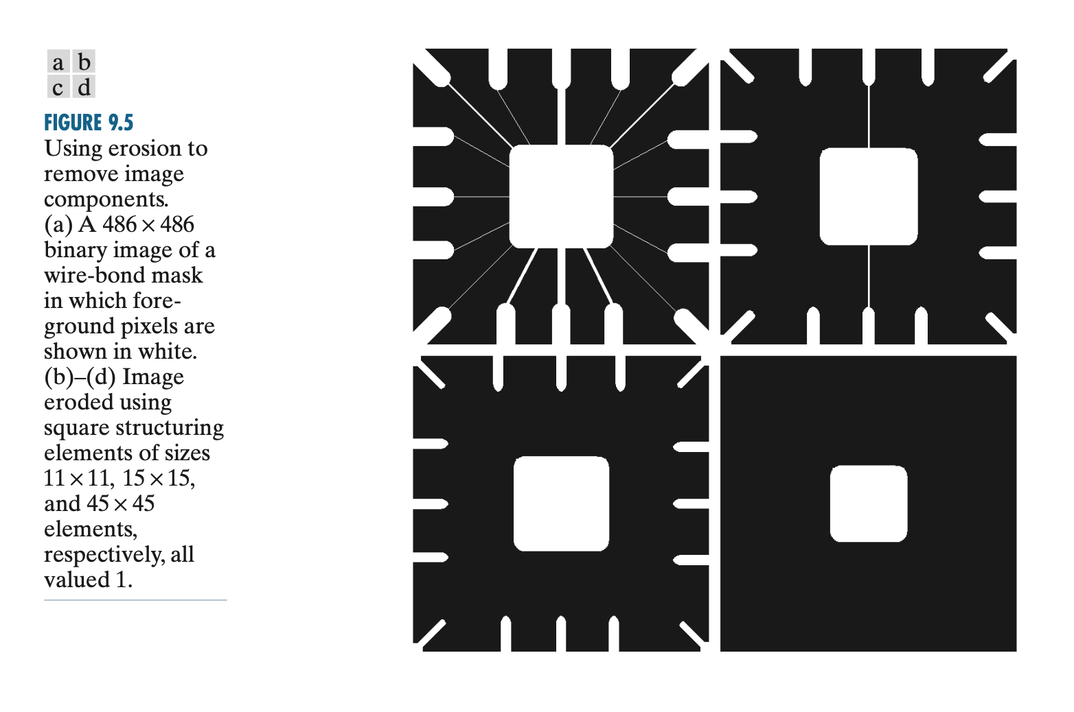

Slide 48
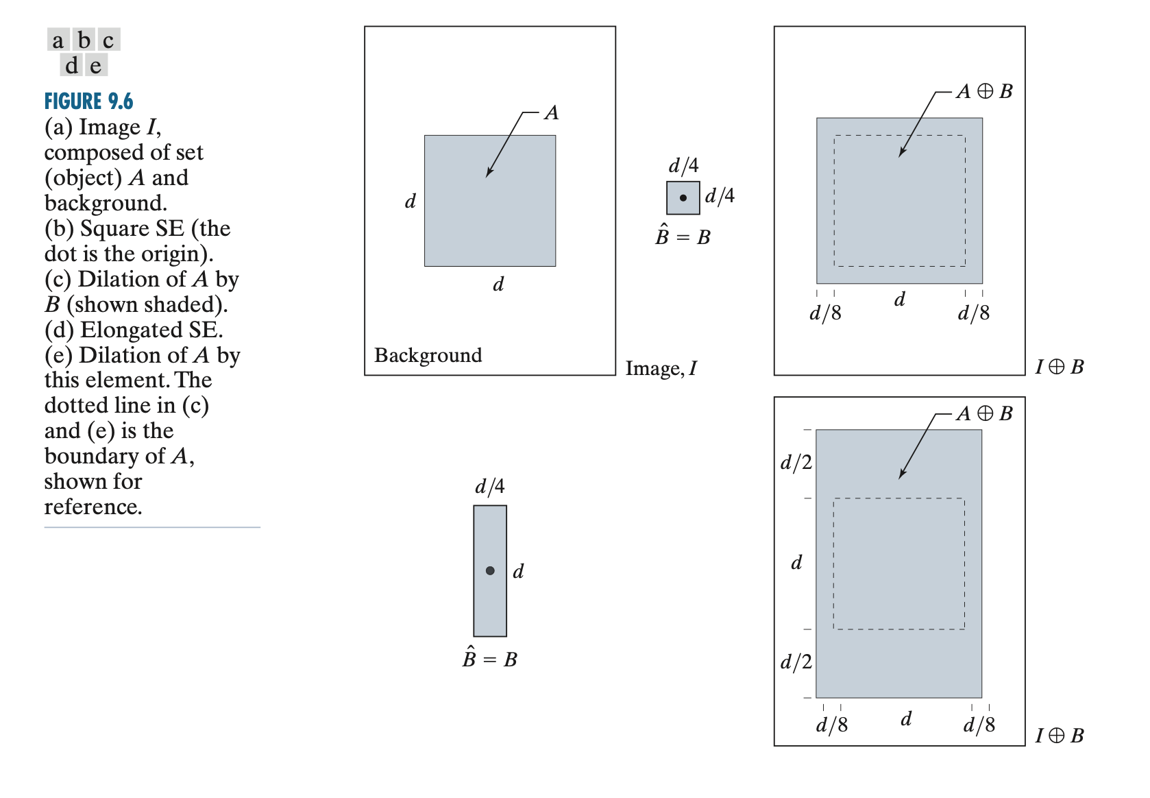
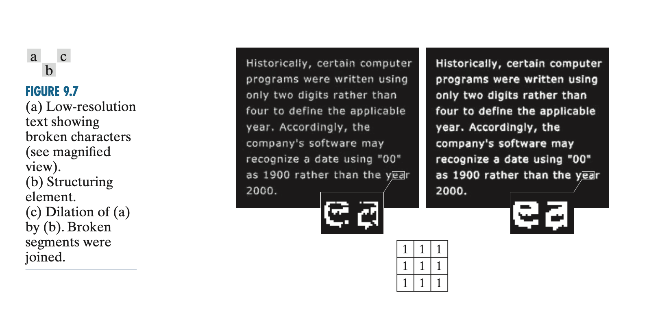

Slide 49
Erosion and Dilation
https://youtu.be/uUweXBmm978?si=ofNIGhLoL_sGRDBc

Slide 50
Opening
Process:
Erosion: Apply erosion to the image.
Dilation: Apply dilation to the eroded image.
Effect: Opening removes small objects and noise while preserving the overall shape of larger objects.

Slide 51
Closing
Process:
Dilation: Apply dilation to the image.
Erosion: Apply erosion to the dilated image.
Effect: Closing fills in holes and connects nearby objects.

Slide 52
The size and shape of the structuring element used in morphological operations can significantly affect the results. Here are some guidelines for choosing a suitable structuring element:
1. Size:
Small structuring elements: These are typically used for removing small details or noise.
Large structuring elements: These are typically used for filling in holes or connecting nearby objects.
The size of the structuring element should be chosen based on the size of the features you want to modify.
2. Shape:
Square or rectangular structuring elements: These are the most common shapes. They are suitable for general-purpose morphological operations.
Circular structuring elements: These are useful for removing or adding circular features.
Cross-shaped structuring elements: These are useful for removing or adding horizontal or vertical lines.

Slide 53
Opening and Closing
https://youtu.be/1owu136z1zI?si=MGsYvwOy5FbaOasp

